Slide 1
Lecture 2: Abstraction and Functions

Slide 2


For fun: Stable Diffusion demo (link)
Prompt: “A dog learning how to program Python and SQL for Data C88C, a data science course. high definition hd 1080p high quality good lighting high resolution”

Slide 3


For fun: Stable Diffusion demo (link)
Prompt: “A dog learning how to program Python and SQL for Data C88C, a data science course. high definition hd 1080p high quality good lighting high resolution”

Slide 4
Announcements
Join the EECS 101 and DATA 001 Ed Discussions!
https://eecs.link/join-ed
https://eecs.link/data-ed
Optional resources for finding additional help on course material.
Hopefully not needed! Please, report any concerns about class / campus climate to the department, CS or DS. You are welcome here!
https://eecs.link/climate

Slide 5
Announcements – Waitlist
Enrolled stats (as of 2024-06-17 11:40 pm pst)
117 / 136 students enrolled, 4 waitlisted
CalCentral:
You need to be in a section to to be enrolled.
Please reach out to advisors about enrollment q's.

Slide 6
Links
Q&A Thread: https://edstem.org/us/courses/59252/discussion/5048437
Self-Check: https://www.gradescope.com/courses/786589/assignments/4509835/
Website Google Calendar: https://c88c.org/su24/weekly-schedule.html
Tip: https://c88c.org now redirects to https://c88c.org/su24

Slide 7
Abstraction

Slide 8

Abstraction
Detail removal
“The act of leaving out of consideration one or more properties of a complex object so as to attend to others.”
Generalization
“The process of formulating general concepts by abstracting common properties of instances”
Technical terms: Compression, Quantization, Clustering, Unsupervized Learning
Henri Matisse “Naked Blue IV”

Slide 9
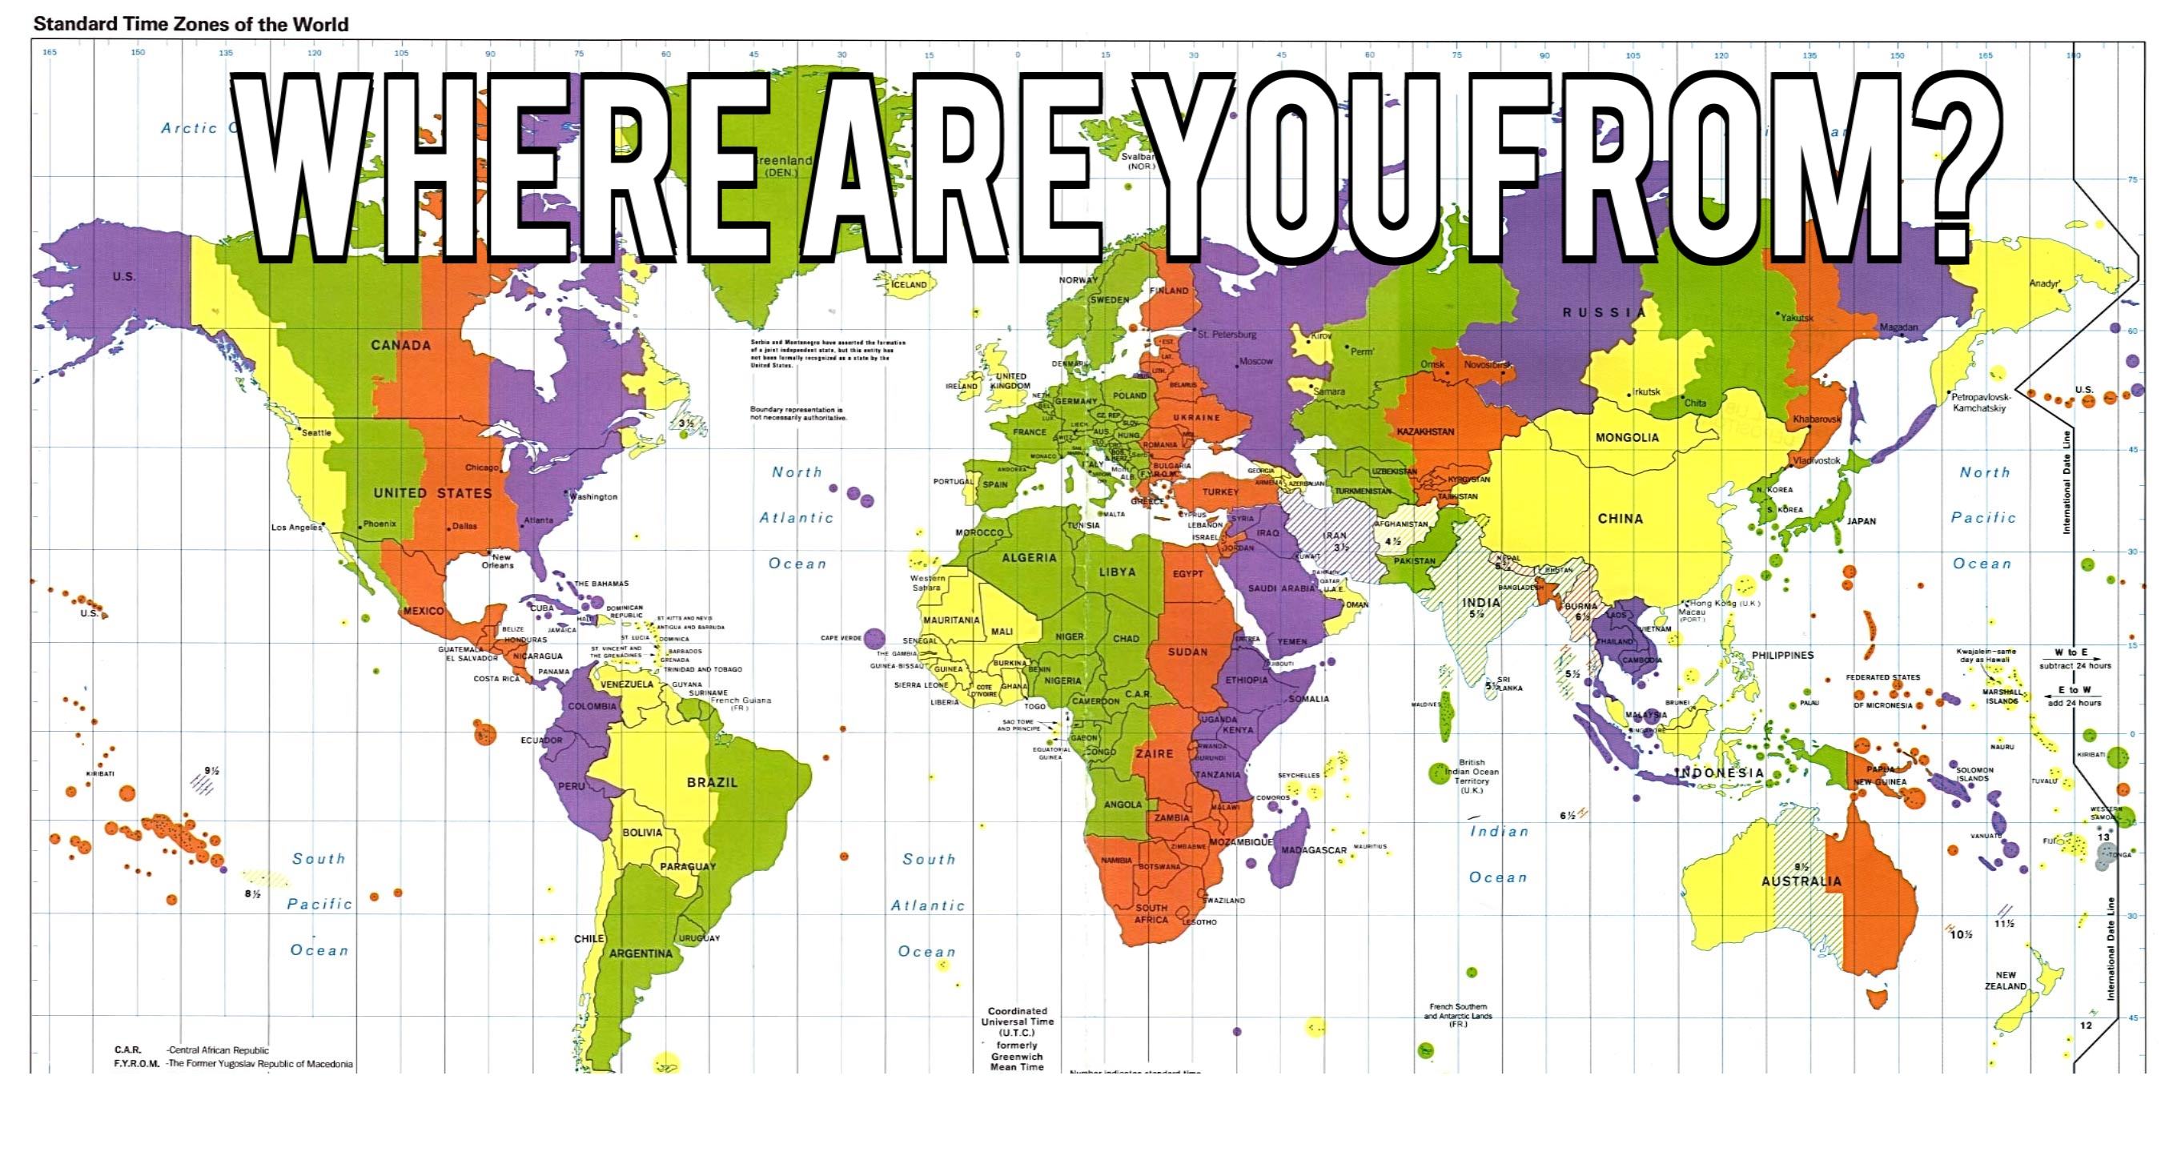
Experiment – Where are you from?

Slide 10

Where are you from?
Possible Answers:
Planet Earth
Europe
California
The Bay Area
San Mateo
1947 Center Street, Berkeley, CA
37.8693° N, 122.2696° W
All correct but different levels of abstraction!

Slide 11
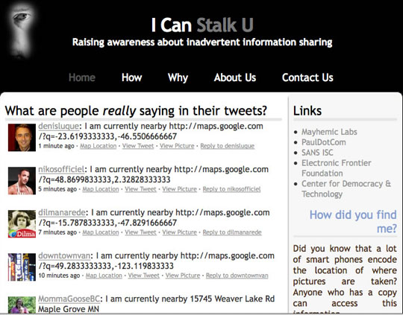
Abstraction gone wrong!

Slide 12
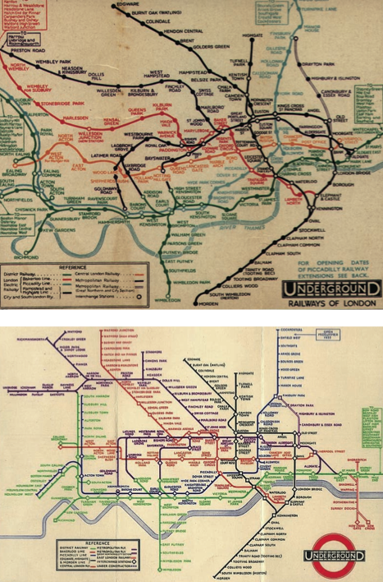
Detail Removal (in Data Science)
You’ll want to look at only the interesting data, leave out the details, zoom in/out…
Abstraction is the idea that you focus on the essence, the cleanest way to map the messy real world to one you can build
Experts are often brought in to know what to remove and what to keep!
The London Underground 1928 Map & the 1933 map by Harry Beck.

Slide 13
The Power of Abstraction, Everywhere!
Examples:
Math Functions (e.g., sin x)
Hiring contractors
Application Programming Interfaces (APIs)
Technology (e.g., cars)
Amazing things are built when these layer
And the abstraction layers are getting deeper by the day!
We only need to worry about the interface, or specification, or contract
NOT how (or by whom) it’s built
Above the abstraction line
Abstraction Barrier (Interface) (the interface, or specification, or contract)
Below the abstraction line
This is where / how / when / by whom it is actually built, which is done according to the interface, specification, or contract.

Slide 14
Abstraction: Pitfalls
Abstraction is not universal without loss of information (mathematically provable). This means, in the end, the complexity can only be “moved around”
Abstraction makes us forget how things actually work and can therefore hide bias. Example: AI and hiring decisions.
Abstractions can formalize a design or pattern. When something doesn't follow that pattern–perhaps a new use case emerges–it can be a burden to adapt.

Slide 15

Algorithm
An algorithm (pronounced AL-go-rith-um) is a procedure or formula to solve a problem.
An algorithm is a sequence of instructions to change the state of a system. For example: A computer’s memory, your brain (math), or the ingredients to prepare food (cooking recipe). Think Data 8: Change or retrieve the content of a table.

Slide 16
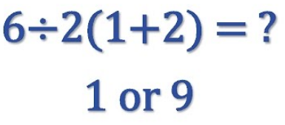
Algorithm: Properties
An algorithm is a description that can be expressed within a finite amount of space and time.
Executing the algorithm may take infinite space and/or time, e.g. ``calculate all prime numbers”.
In CS and math, we prefer to use well-defined formal languages for defining an algorithm.

Slide 17
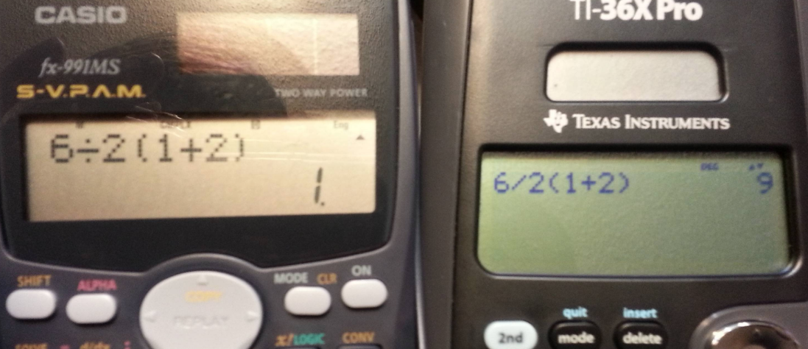
Algorithm: Well-Definition

Slide 18
Algorithms Early In Life (1st Grade)
1
carry (MSD)
7
operands
operator
+
8
5
least significant digit of result

Slide 19
Algorithms Early In Life (In Binary)
1
1
0
0
carry (MSD)
1
1
1
0
14
operands
1
1
0
0
+
12
operator
+
1
1
0
1
0
26
LSB result

Slide 20
More Terminology (Intuitive)
Code
A sequence of symbols used for communication between systems (brains, computers, brain-to-computer)
Data
Observations
Information
Reduction of uncertainty in a model (measured in bits)

Slide 21
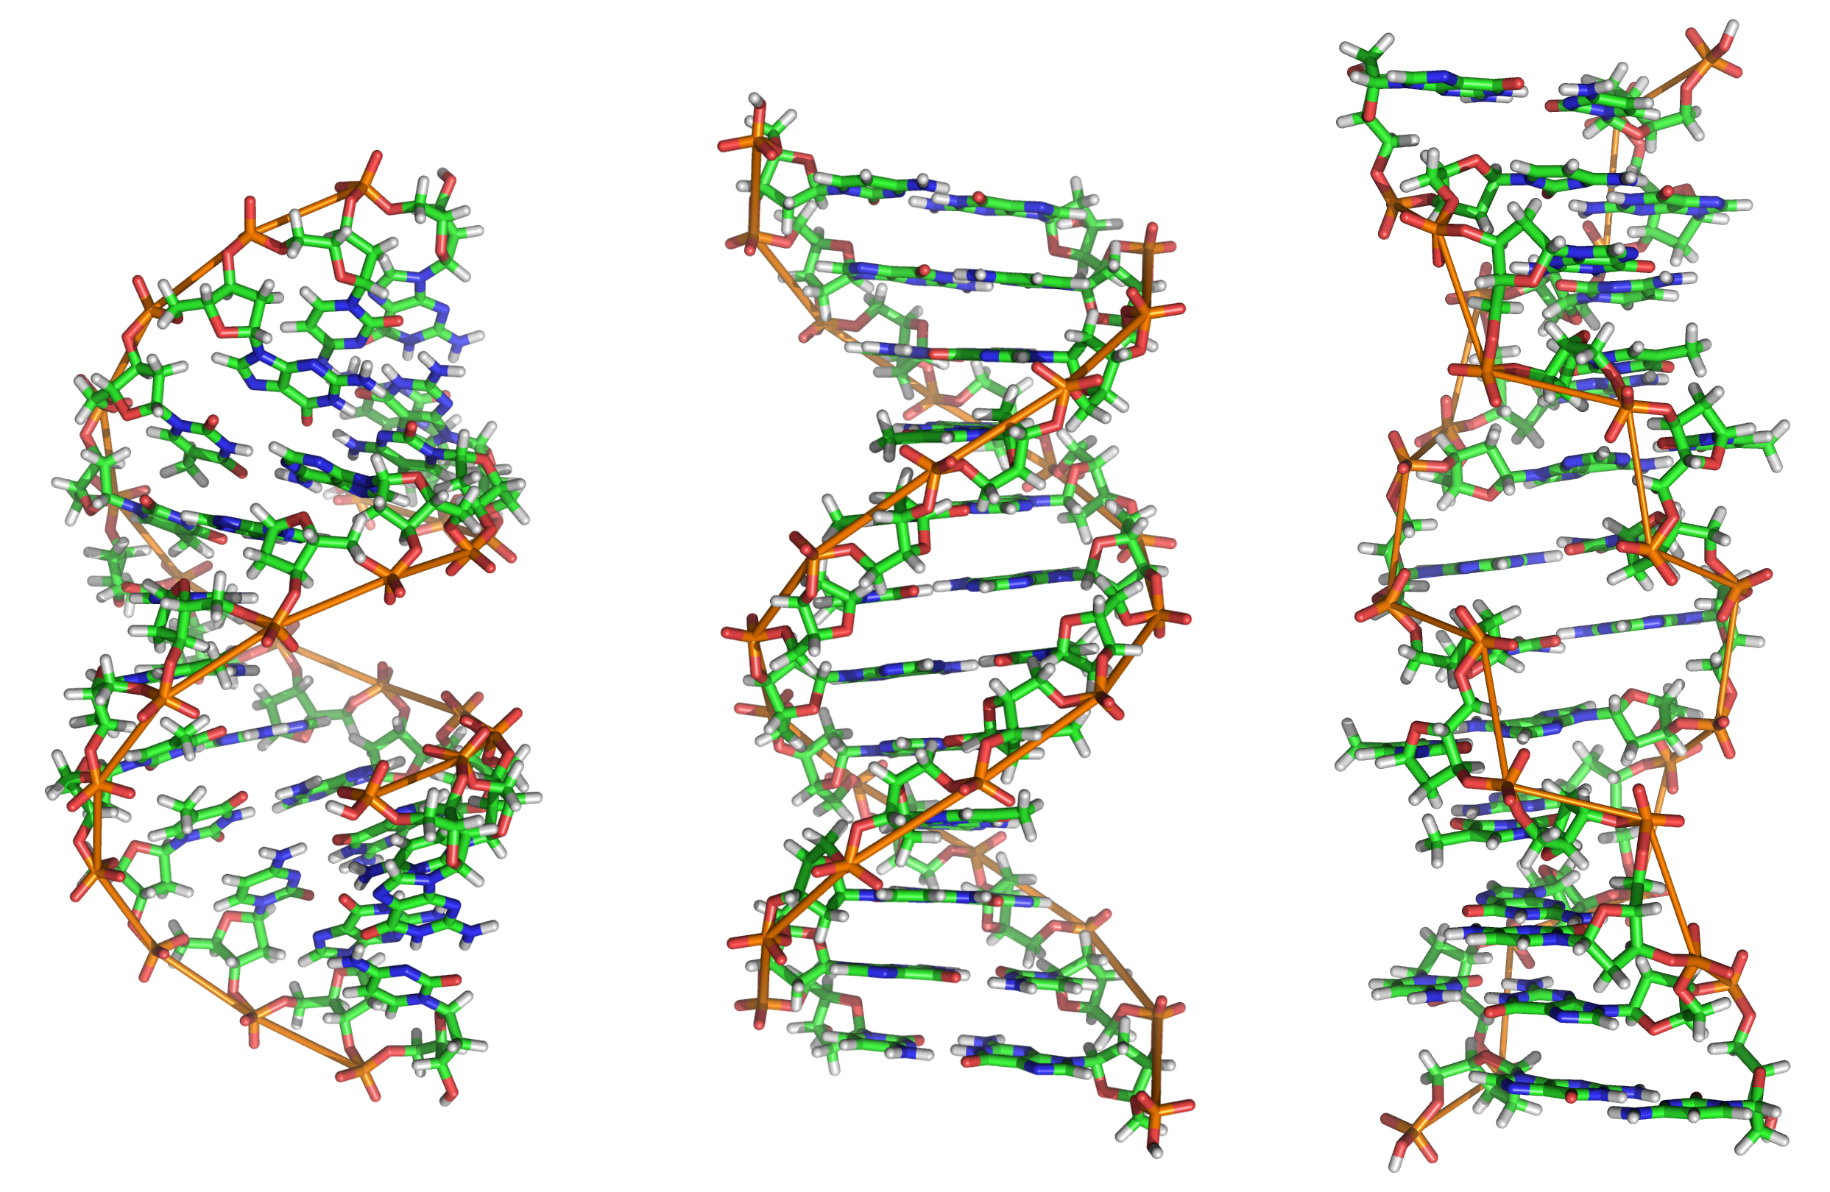
Data or Code?

Slide 22
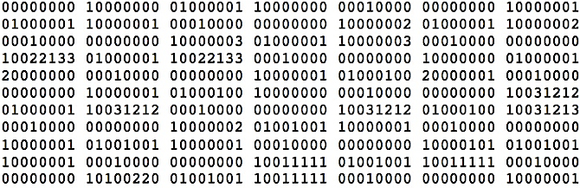
Data or Code?

Slide 23
Data or Code?
Here is some information!
Integer
Instruction
String

Slide 24
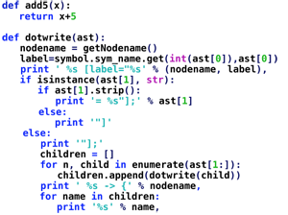
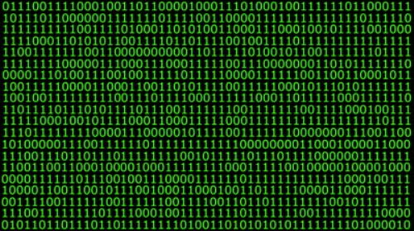
Data or Code? Abstraction→ Take CS61C
Human-readable code (programming language)
Machine-executable instructions (byte code)
Compiler or Interpreter
Here: Python

Slide 25
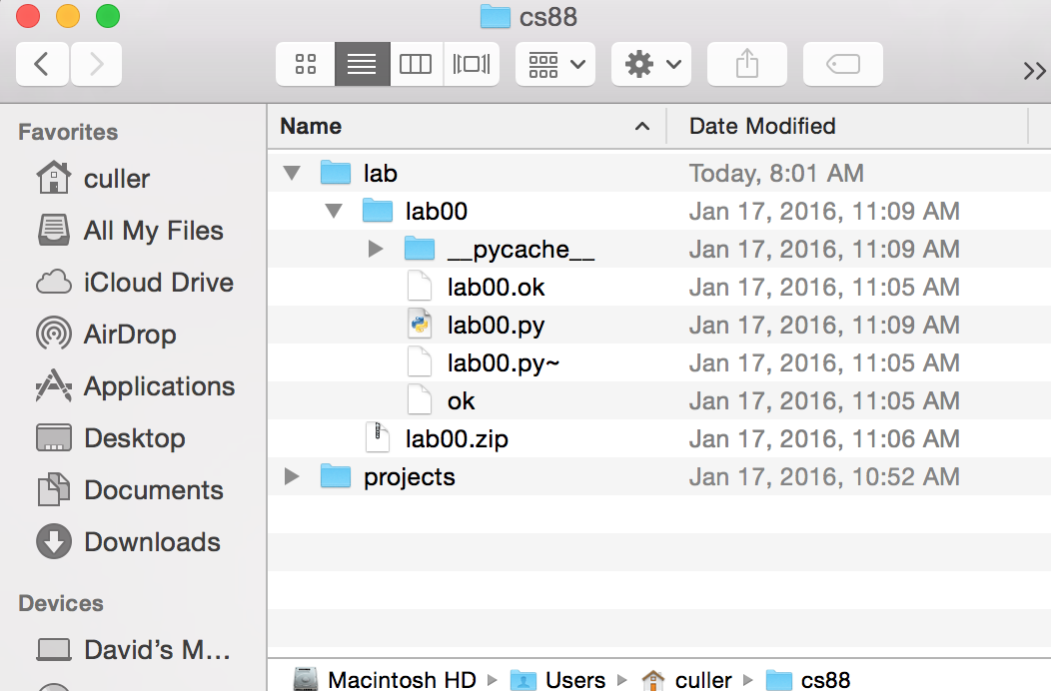
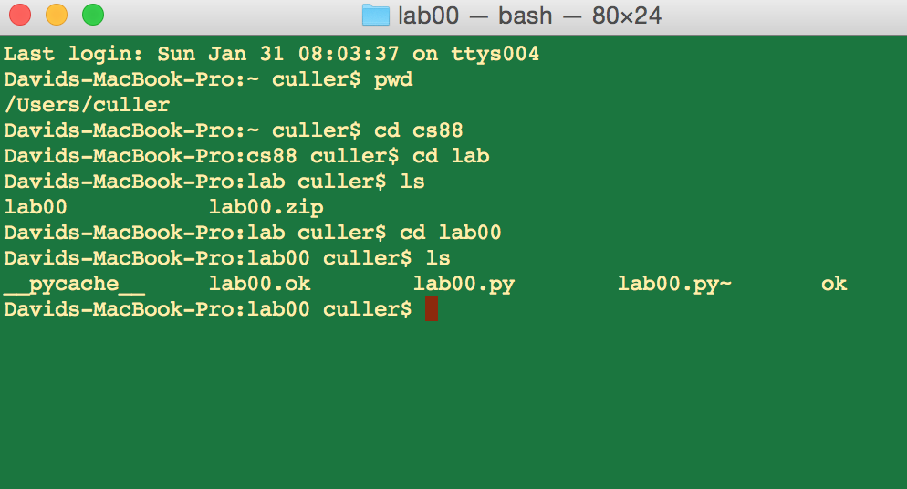
Computers Are Built On Abstractions
Big Idea: Layers of Abstraction
The GUI look and feel is built out of files, directories, system code, etc.

Slide 26
Review:
Abstraction:
Detail Removal or Generalizations
Code:
Is an abstraction!
Computer Science is the study (and building) of abstractions

Slide 27
Python: Expressions and Statements

Slide 28
Learning Objectives
Evaluate expressions in Python
Name data so it can be used later.
Get practice with the Python Interpreter

Slide 29
Demo!
Run the Python interpreter (python3) on your computer
Practice seeing the results of expressions
Use Control-L to clear the screen
Use Control-D or type exit() to exit Python.
The interpreter does not save any work!

Slide 30
Let’s talk Python
Expression
Call expression
Variables
Assignment Statement
Define Statement
Control Statements
Comments
8 * 11
max(88, 61)
greeting
greeting = <expression>
def name(<arguments>):
if, else, for, while …
# Text are a # is ignored.

Slide 31
Expressions
An expression is code that produces or evaluates to a value.
A call expression simply means that expression involves calling a function.
8 * 11
8 + 80
max(88, 61)
len('Berkeley')

Slide 32
Names and Statements
Statements are code that does something, but does not produce a value!
Assignment Statements bind some value to a name which can be used later. (A variable)
print('Welcome to 88C!')
course = '88C'
print('Welcome to ' + course + '!')

Slide 33
Numbers (int and float)
Numbers come in two types: integers, and decimals
Why? Partially historical reasons, partially for speed
Python is forgiving!
In most cases you can mix them up just fine.
Numbers support many common operations:
+, -, /, *, ** (power), % (modulus), // (floor division)
Try: import math
Lots of math examples

Slide 34
Strings and Text
Data inside quotes "" is called a string
Python allows single quotes or double quotes
Strings support useful operations like concatenation with +
"f-strings" allow us to nicely format text
f"Hello, {course}!"
f"2 times 2 is {2*x}"

Slide 35
Boolean Expressions
Booleans are Yes/No values.
In Python: True and False
>, <, ==, !=, >=, <=, and, or
Note the the "double equals"
These expressions all return only True or False.
3 < 5 # returns True
You can write 3 < 5 == True – but this is redundant.
We'll keep practicing over time

Slide 36
Boolean Expressions: and and or
And and Or tell us the result of combining Boolean expressions
and evaluates to True when both a and b are True
or evaluates to True when either a or b is True
Expression | Result
True and True | True
True and False | False
False and True | False
False and False | False
Expression | Result
True or True | True
True or False | True
False or True | True
False or False | False

Slide 37
Statements and Expressions: Review
Expressions evaluate to a result
We can combine expressions for more complex problems
We assign names to values using =

Slide 38
Live Coding Demo
Open Terminal on the Mac
Type python3
We are now in the "interpreter" and can type code.
Python runs each line of code as we type it.
After each line, we see a result. This happens only in the interpreter.
It's a very useful calculator.
We can also run files!
python3 -i 02-Functions.py
-i : This means open the interpreter after running the file. It's optional
python3 ok …
This runs the file "ok" which is included with each lab / homework.

Slide 39
Python: Control Flow

Slide 40
Conditional Statement
Do some statements, conditional on a predicate expression
Example:
if <predicate>:
<true statements>
else:
<false statements>
if temperature > 98.6:
print(“fever!”)
else:
print(“no fever”)

Slide 41
Live Coding Demo
course = 'C88C'
time = '1:00'
if time == '1:00':
print("Go to " + course)
else:
print("Go to some other class")
Go to C88C

Slide 42
Live Coding Demo
>>> course = 'C88C'
>>> time = '1:00'
>>> if time == '1:00':
... print("Go to " + course)
... else:
... print("Go to some other class")
...
Go to C88C

Slide 43
Function Definitions

Slide 44
Defining Functions
Abstracts an expression or set of statements to apply to lots of instances of the problem
A function should do one thing well
def <function name> (<argument list>) :
return
expression

Slide 45
Functions: Example
Let’s write a simple function which returns 8 more than the number.
We will call this function by writing add_8(80).
Inside, the name num will become the value 80.
def add_8(num):
"""add 8 to the input num
>>> add_8(80)
88
"""
return 8 + num

Slide 46
Functions in Python
We "define" them with def
We typically name_them_using_underscores ("Snake case")
The first line ends in a :
The body is indented by 4 spaces (or 1 tab)
Arguments (parameters) create 'names' that exist only in our function
All functions return some value
We usually use return
If we omit return, the value is None

Slide 47
Function Arguments
When we define a function, we provide 0 or more arguments
Arguments define names that exist only within the function
When we call a function, we pass parameters to the function
Each parameter is mapped 1-to-1, left-to-right to an argument
def is_even(x):
return x % 2 == 0
is_even(2)

Slide 48
Functions: Example
>>> y = 5
>>> x = 3
>>> z = max(x, y)
>>> z
5
def max(x, y):
if x > y:
return x
else:
return y

Slide 49
How to Write a Good Function
Give a descriptive name
Function names should be lowercase. If necessary, separate words by underscores to improve readability. Names are extremely suggestive!
Chose meaningful parameter names
Again, names are extremely suggestive.

Slide 50
Live Coding Demo
Make and call simple functions

Slide 51
Outro
Today we went over:
Abstractions
Intro to Python syntax
Expressions, Statements, Control Flow, Functions (preview)

Slide 52
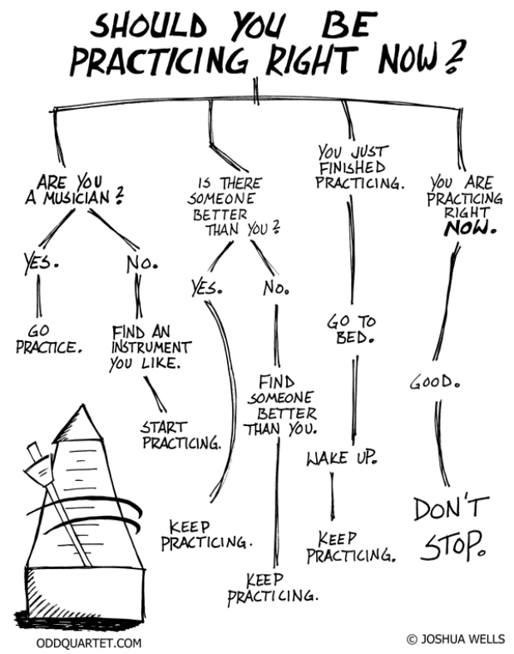
Outro
You may feel like Python code is still a mystery…
…and you’d (probably) be right! And that’s 100% OK!

Slide 53
Outro
Learning to code requires HANDS-ON, deliberate practice. Like a craft (woodworking, music, etc)
Good news: this is what Labs, HWs, and projects are for!
So, keep up the practice, and stay curious + motivated ☺

Slide 54
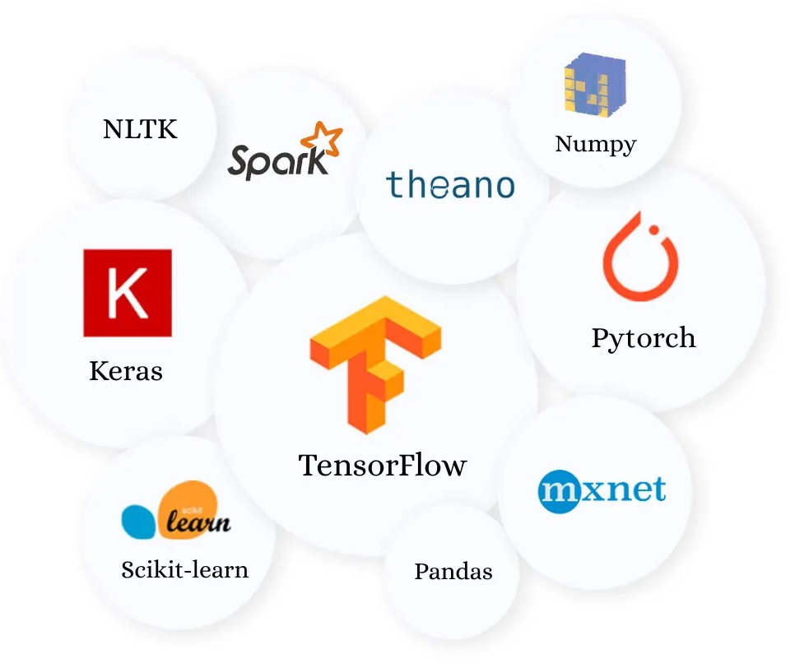
Outro
Exciting news: it’s never been easier to get into coding/CS/AI/ML/data-science
libraries like pytorch, tensorflow, pandas, scikit-learn, etc have dramatically lowered the barrier of entry in the past 7 years
Ex: In just a few hours of setup, an individual can conceivably start training a state-of-the-art ML model (modulo expensive $ GPU hardware)
Image from: https://towardsdatascience.com/best-python-libraries-for-machine-learning-and-deep-learning-b0bd40c7e8c

Slide 55
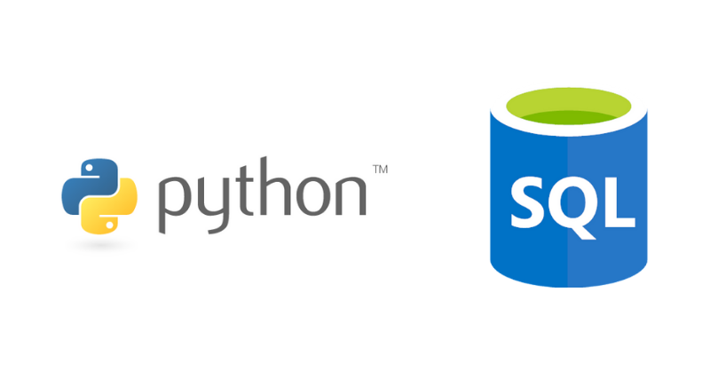
Outro
And, for what it’s worth: a LOT of data science work (in both industry and academia) these days is done in Python + SQL.
Thus, all of your hard work this summer will be 100% worth it!
Secret fun fact: a lot of work is also done in Excel / Google Sheets. Even in CompSci! Haha. Semi joking :P

Slide 56
Questions?
Questions?

Slide 57
Functions and Environments

Slide 58
Functions: Calling and Returning Results
Python Tutor
def max(x, y):
return x if x > y else y
x = 3
y = 4 + max(17, x + 6) * 0.1
z = x / y

